Slide 1
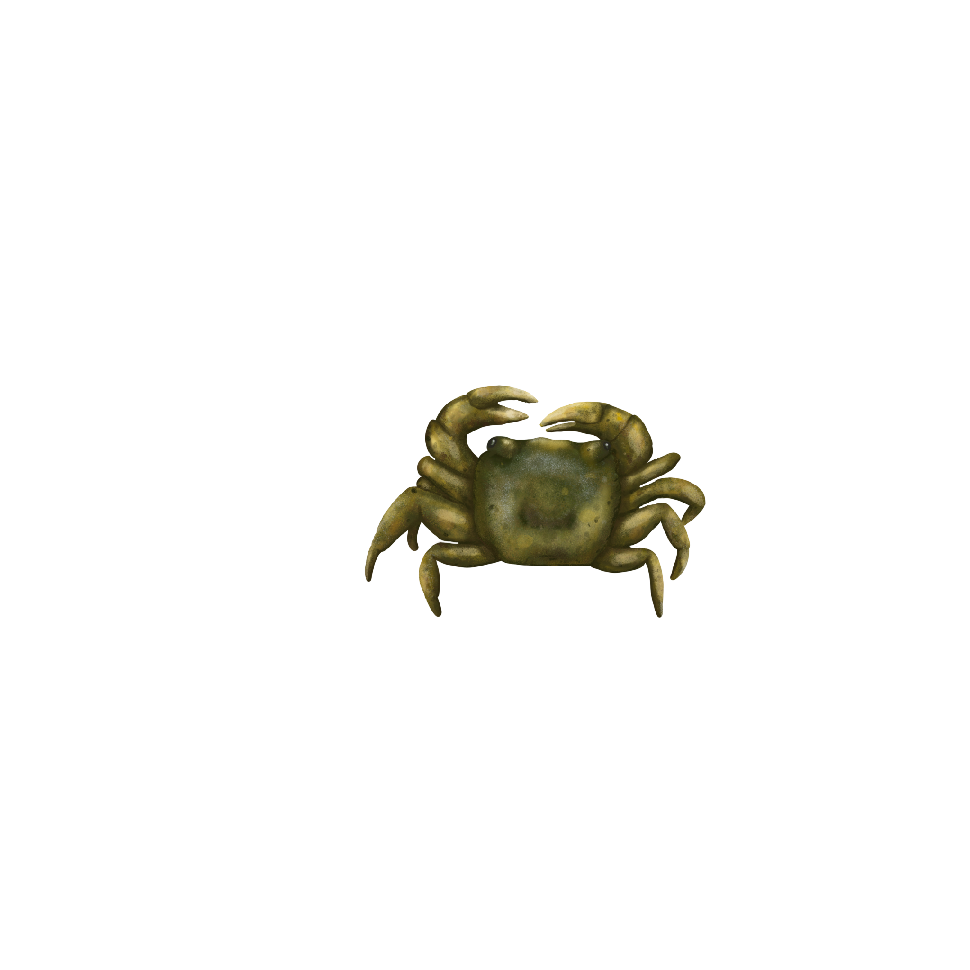
Impacts of temperature on immune response in Hemigrapsus oregonensis
Emily, Isaac, Kea, Luke

Slide 2
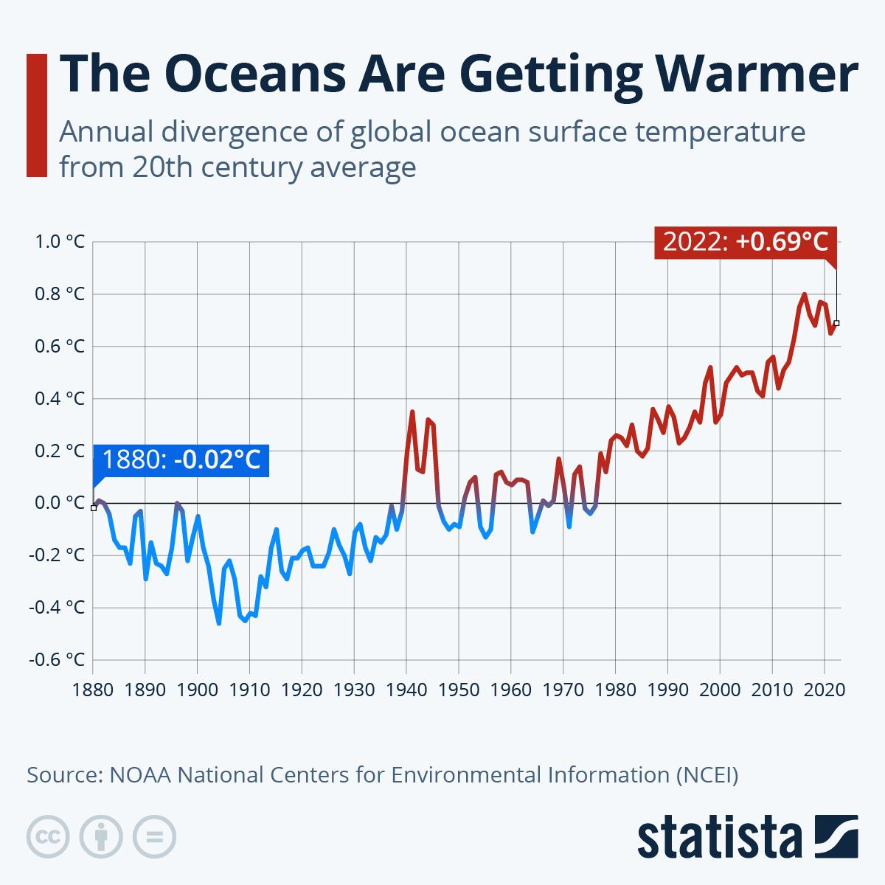
Background - Warming Oceans
2024 was the warmest recorded year for sea surface temperature
Marine heat waves are increasing in frequency
Warmer ocean temperatures impact species distributions, reproductive success, and metabolic rates
Fisheries and economic impacts
https://www.statista.com/chart/19418/divergence-of-ocean-temperatures-from-20th-century-average/
Climate change indicators: Sea surface temperature. (2023, July 21). US EPA. https://www.epa.gov/climate-indicators/climate-change-indicators-sea-surface-temperature
Notes:
summary

Slide 3
Background - Snow Crab Fishery Collapse
In 2018-2019 the Bering Sea snow crab population declined by 90%
Snow crab fishery value before the collapse was estimated to be $227 million.
Potential Causes:
Range shift
Starvation due to increased metabolism
Increase in bitter crab disease
How does heat stress affect crab’s immune systems?

Slide 4
Background - Thermal Stress in Invertebrates
Ectothermic organisms’ physiology can be significantly impacted by temperature changes (Shields 2019)
H. oregonensis is tolerant of temperatures from ~3 – 27°C (Dehnel 1960)
Increases in body temperature generally lead to increases in oxygen consumption (Dehnel 1960)
Thermal stress results in lower threshold barrier to infection (Shields 2019)

Slide 5
Background - Invertebrate Immune Response
Invertebrates under additional stressors exhibit a decrease in immune response (Adamo 2012)
The innate immune response of invertebrates depends on haemocytes to phagocytize pathogens (Adamo 2012)
High and low temperature extremes heavily impact crab immune systems (Truscott and White 1990)

Slide 6
Background - Pathogens and Climate Change
Host-pathogen dynamics are changing in four key ways (Cohen 2018):
Host stress levels
Pathogen transmission
Pathogen habitat and range
Host habitat and range
Habitat preference plays an important role (Dittmer 2011)
!

Slide 7
Research Gap
Understood susceptibility of crabs to parasitism under stress, but a lacking understanding exists of how locally present parasites interact with H. Oregonensis
Host - pathogen interactions in commercially important hosts (H. Oregonensis as a proxy)

Slide 8
Hypothesis:
Null hypothesis: Haemocyte concentrations and stress does not change in Hemigrapsus oregonensis treatments with higher temperatures.
Alternative hypothesis: Higher temperatures result in increased stress levels and decreased haemocyte concentrations in Hemigrapsus oregonensis when exposed to pathogens.

Slide 9
Sub-Alternative Hypothesis
Under heat-stress conditions…
Righting time
Glucose
Lactate
Triglycerides
BCA Protein
Osmolarity
Oxygen consumption
Haemocyte concentration
compared to control conditions.
Notes:
Higher levels of glucose in crabs can indicate normal and thermal stress, due to excess Crustacean hyperglycemic hormones (CHHs) being released.

Slide 10
Sub-Alternative Hypothesis
Under heat-stress conditions…
Righting time
Glucose
Lactate
Osmolarity
Oxygen consumption
INCREASE
compared to control conditions.
Notes:
Higher levels of glucose in crabs can indicate normal and thermal stress, due to excess Crustacean hyperglycemic hormones (CHHs) being released.

Slide 11
Sub-Alternative Hypothesis
Under heat-stress conditions…
BCA Protein
Triglycerides
Haemocyte concentration
DECREASE
compared to control conditions.
Notes:
Higher levels of glucose in crabs can indicate normal and thermal stress, due to excess Crustacean hyperglycemic hormones (CHHs) being released.

Slide 12
Sub-Alternative Hypothesis
A: Righting time - Crabs treated with warmer temperatures and immune challenge presence (mud) will take longer to right themselves than control crabs.
B: Glucose - Crabs treated with warmer temperatures and immune challenge presence will experience higher haemolymph glucose levels than control crabs.
C: Lactate - Crabs treated with warmer temperatures and immune challenge presence will experience higher haemolymph lactate levels.
D: Triglycerides - Crabs treated with warmer temperatures and immune challenge presence will experience decreased levels of triglycerides compared to control crabs.
E: BCA Protein - Crabs treated with warmer temperatures and immune challenge presence will experience decreased levels of BCA proteins compared to control crabs.
F: Osmolarity - Crabs treated with warmer temperatures
G: Respirometry - Crabs treated with warmer temperatures and immune challenge presence will experience increased respiratory rates compared to control crabs.
H: Haemocyte Concentration - Crabs treated with warmer temperatures will experience decreased haemocyte concentrations compared to control crabs.
Notes:
Higher levels of glucose in crabs can indicate normal and thermal stress, due to excess Crustacean hyperglycemic hormones (CHHs) being released.

Slide 13
Treatment Groups and Experimental Design
Group 1: Control, no Mud
Group 2: Control, Mud
Group 3: Heat, Mud
Group 4: Heat, No Mud
Five Crabs
~13°C.
No Mud
1-2 covers
Five Crabs
~13°C.
1 ½ inches of mud
1-2 covers
Five Crabs
30°C.
1 ½ inches of mud
1-2 covers
Five Crabs
30°C.
No Mud
1-2 covers

Slide 14
Treatment Groups and Experimental Design
Temperature
Mud
Covers
A temperature increase to 30 C was chosen to simulate possible temperature changes due to climate change.
Needed a temperature high enough to trigger changes without heating beyond crab’s ability to adapt. This temperature was chosen based off of papers performing similar research.
A layer of mud, roughly 1 ½ inches deep was chosen to simulate bacteria and infectants crabs may be exposed to in their natural habitat.
Covers, numbering 1-2, will be placed in the tanks to simulate rocks and other natural habitat structures crabs can use to hide or for protection.
These will be placed in all tanks to help prevent additional stress due to being exposed.

Slide 15
Stress and Immune Response Measurements
Haemocyte Concentration
Immune Response:
Will be measured by: counting haemocytes in a hemocytometer
Physiological assays
Stress:
Will be measured by: Righting time, extracting haemolymph to measure Glucose, Lactate, Triglycerides, BCA protein, Osmolarity
Respirometry
Stress:
Will be measured by: Resazurin assay

Slide 16
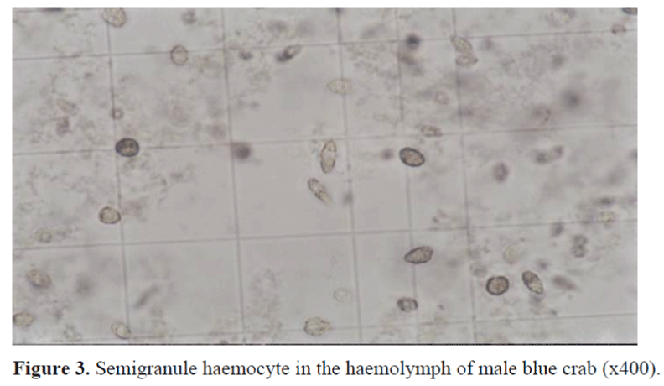
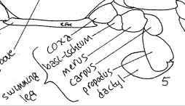
Haemocyte Concentration
Using a needle to break through the membrane, we can extract haemolymph from the merus of the leg of the crab.
We can then use a haemocytometer
https://www.itmedicalteam.pl/articles/determination-of-haemocytes-amount-and-haemocytes-type-in-mature-blue-crab-callinectes-sapidus-rathbun-1896-captured-in--105084.html
https://lanwebs.lander.edu/faculty/rsfox/invertebrates/callinectes.html
Notes:
Using a syringing needle to break through the arthrodial membrane, we can extract haemolymph from the merus of the swimming leg of the crab.
We can then use a haemocytometer to count the haemocyte concentration within the crab’s haemolymph.

Slide 17
Haemocyte Concentration
Using a syringing needle to break through the arthrodial membrane, we can extract haemolymph from the merus of the swimming leg of the crab.
We can then use a haemocytometer to count the haemocyte concentration within the crab’s haemolymph.
https://www.itmedicalteam.pl/articles/determination-of-haemocytes-amount-and-haemocytes-type-in-mature-blue-crab-callinectes-sapidus-rathbun-1896-captured-in--105084.html
https://lanwebs.lander.edu/faculty/rsfox/invertebrates/callinectes.html

Slide 18
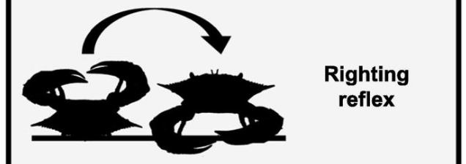
Physiological Assays
In order to measure righting time we will flip the crabs onto their back and time how long it takes them to get back into an upright position again.
To measure the glucose level of the crabs’ haemolymph, we will be using the glucose oxidase method.
Lactate can be extracted from haemolymph and measured using an enzymatic assay.
https://www.sciencedirect.com/science/article/pii/S0048969723008768
Notes:
In order to measure righting time we will flip the crabs onto their back and time how long it takes them to get back into an upright position again. This will be done multiple times and the average righting time will be taken into consideration.
To measure the glucose level of the crabs’ haemolymph, we will be using the glucose oxidase method. Glucose reacts with glucose oxidase forming hydrogen peroxide and gluconic acid. The hydrogen peroxide can then be measured using peroxidase and a chromogen (such as 2-amino-4-hydroxybenzenesulfonic acid (AHBS)).
Lactate can be extracted from haemolymph and measured using an enzymatic assay. One assay is very similar to the glucose oxidase assay, using lactate oxidase to produce pyruvate, which then produces hydrogen peroxide which can be measured using a peroxidase and chromogen, as discussed above.

Slide 19
Physiological Assays
In order to measure righting time we will flip the crabs onto their back and time how long it takes them to get back into an upright position again. This will be done multiple times and the average righting time will be taken into consideration.
To measure the glucose level of the crabs’ haemolymph, we will be using the glucose oxidase method. Glucose reacts with glucose oxidase forming hydrogen peroxide and gluconic acid. The hydrogen peroxide can then be measured using peroxidase and a chromogen (such as 2-amino-4-hydroxybenzenesulfonic acid (AHBS)).
Lactate can be extracted from haemolymph and measured using an enzymatic assay. One assay is very similar to the glucose oxidase assay, using lactate oxidase to produce pyruvate, which then produces hydrogen peroxide which can be measured using a peroxidase and chromogen, as discussed above.

Slide 20
Physiological Assays
Triglycerides extracted from homogenized crab tissue can be measured using enzymatic assays.
To measure protein concentration, a BCA (Bicinchoninic Acid) assay can be used, the more purple the final solution is, the higher the protein concentration.
Measuring osmolarity in crabs can be done by collecting haemolymph and using a vapour pressure osmometer or cryoscopic osmometer
Notes:
Triglycerides can be measured by taking crab tissue and homogenizing it. They can then be extracted using methanol/chloroform and measured using methods such as enzymatic assays.
To measure protein concentration, a BCA (Bicinchoninic Acid) assay can be used by mixing the sample with a BCA reagent and using a spectrophotometer to measure colour absorbance. The more purple the final solution is, the higher the protein concentration from the sample.
Measuring osmolarity in crabs can be done by collecting haemolymph and using a vapour pressure osmometer or cryoscopic osmometer

Slide 21
Physiological Assays
Triglycerides can be measured by taking crab tissue and homogenizing it. They can then be extracted using methanol/chloroform and measured using methods such as enzymatic assays.
To measure protein concentration, a BCA (Bicinchoninic Acid) assay can be used by mixing the sample with a BCA reagent and using a spectrophotometer to measure colour absorbance. The more purple the final solution is, the higher the protein concentration from the sample.
Measuring osmolarity in crabs can be done by collecting haemolymph and using a vapour pressure osmometer or cryoscopic osmometer

Slide 22
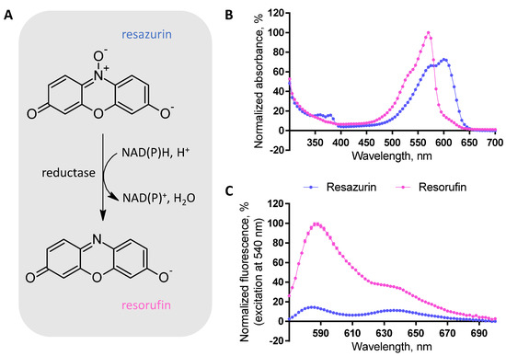
Respirometry
The Resazurin Assay can be used as an indirect measurement of respiration rate.
Fluorescence spectrometry can measure the concentration of resorufin using the red colour.
Notes:
The Resazurin Assay, is a downstream indicator of cellular metabolic activity, and while not a direct indicator of respiration metabolic rate, it has been closely linked to respiration rate.
The reduction of blue resazurin to red resorufin, can be measured using fluorescence spectrometry or a colorimeter.

Slide 23
Respirometry
The Resazurin Assay, is a downstream indicator of cellular metabolic activity, and while not a direct indicator of respiration metabolic rate has been closely linked to respiration rate.
Measurement through the reduction of blue resazurin to red resorufin, which can be determined using fluorescence spectrometry or a colorimeter.

Slide 24
Our experiment will use the yellow shore crab (H. oregonensis) as a proxy for the Dungeness crab (M. magister).
The aim of this experiment is to study how rising temperatures due to climate change may affect disease and infection rates in Dungeness crab. Bitter crab disease has big impacts on fisheries, costing millions of dollars. An increase of bitter crab disease and others could be greatly detrimental to Washington fisheries.
-find out value of dungeness fishery
-talk about importance of dungeness to economy, culture/tourism/tribes
-bitter crab disease
-investigate income lost from bcb and other crab diseases.

Slide 25
Limitations
Mud sample is highly variable factor with little control on our end
Simple one host scenarios involving just H. oregonensis and lacks definitive hosts
Confounding aggregators of stress forcing on crabs
Temperature
# of crabs confined to space
Peripheral movement
Incapacity to observe specific parasites

Slide 26
Relevance to real-world ecological or management outcomes
Our experiment will use the yellow shore crab (H. oregonensis) as a proxy for the Dungeness crab (M. magister).
The 2023-2024 Dungeness crab season ex-vessel value in washington state was $66.8 million
Dungeness crabs are harvested by the Hoh, Quinault, Makah, and Quileute tribes
Will rising ocean temperatures affect the Dungeness crab’s ability to fight diseases like BCB?
Notes:
methodology

Slide 27
Project Timeline and Milestones
Today (project proposal)
April 29th - Study setup
April 29th - Data collection
May 6th - Data collection
May 13th - Data collection
Hypothesis defense and initial results
Preliminary paper
Final presentation
Notes:
Timeline and Milestones

Slide 28
Works Cited:
Adamo, S. A. (2012). The effects of the stress response on immune function in invertebrates: An evolutionary perspective on an ancient connection. Hormones and Behavior, 62(3), 324–330. https://doi.org/10.1016/j.yhbeh.2012.02.012
Alaska Fisheries Science Center. (2025, March 3). Snow crab collapse due to ecological shift in the Bering Sea. NOAA Fisheries. https://www.fisheries.noaa.gov/feature-story/snow-crab-collapse-due-ecological-shift-bering-sea
Climate change indicators: Sea surface temperature. (2023, July 21). US EPA. https://www.epa.gov/climate-indicators/climate-change-indicators-sea-surface-temperature
Cohen, R.E., C.C. James, A. Lee, M.M. Martinelli, W.T. Muraoka, M. Ortega, R. Sadowski, L. Starkey, A.R. Szesciorka, S.E. Timko, E.L. Weiss, and P.J.S. Franks. 2018. Marine host-pathogen dynamics: Influences of global climate change. Oceanography 31(2):182–193, https://doi.org/10.5670/oceanog.2018.201.
Dehnel L, P. A. (1960). Effect of temperature and salinity on the oxygen consumption of two intertidal crabs. The Biological Bulletin, 118(2), 215–249. https://doi.org/10.2307/1538998
Dittmer, J., Koehler, A. V., Richard, F.-J., Poulin, R., & Sicard, M. (2011). Variation of parasite load and immune parameters in two species of New Zealand shore crabs. Parasitology Research, 109(3), 759–767. https://doi.org/10.1007/s00436-011-2319-2
Shields, Jeffery, Climate change enhances disease processes in crustaceans: case studies in lobsters, crabs, and shrimps, Journal of Crustacean Biology, Volume 39, Issue 6, November 2019, Pages 673–683, https://doi.org/10.1093/jcbiol/ruz072

Slide 29
Works Cited:
Snow crab collapse due to ecological shift in the Bering Sea. (2024, August, 21). NOAA. https://www.fisheries.noaa.gov/feature-story/snow-crab-collapse-due-ecological-shift-bering-sea
Truscott, R., & White, K. N. (1990). The Influence of Metal and Temperature Stress on the Immune System of Crabs. Functional Ecology, 4(3), 455–461. https://doi.org/10.2307/2389609
Washington Coastal Dungeness Crab Fishery Newsletter. (2024). Washington Department of Fish & Wildlife. https://wdfw.wa.gov/sites/default/files/2025-01/newsletter-dungeness-crab-fishery-2024-5.pdf

Slide 30
Proposal assignment requirements
From the ROP
Project Title and Summary (max 300 words)
Research Objectives and Background
Methodology, including stressor types and physiological metrics
Relevance to real-world ecological or management outcomes
Timeline and Milestones
Experimental Design and Justification
From the slides assignment:
We expect you to prepare a 10-15 min group presentation using PowerPoint slides.
You must include a background (using relevant literature) leading to a general research question, and a set of specific
hypothesis (framed as null and alternative hypotheses)
You must include a very specific experimental design, making sure that results generated therein will answer the
hypothesis you propose. Don't forget the use replicates.
Be ready to receive feedback and to answer questions. You will be graded on both the presentation of your project, and the
defense of it (your response to questions from the audience, including the teaching team). Expect to use the whiteboard to
answer some of the questions.
Every member of the research team must participate in the presentation and defense of the project, otherwise members that do
not engage will be penalized with a 20% penalty in their grade.

Slide 31
Summary
The collapse of the Bering Sea snow crab fishery and the mystery surrounding it necessitates a cultivation of knowledge surrounding crab physiology and ecology. Marine heatwaves, proximal to global temperature forcing upon oceans, is the culprit behind a population decline of over 10 billion individuals (Szuwalski et al. 2023; ) in
Notes:
summary

Slide 32
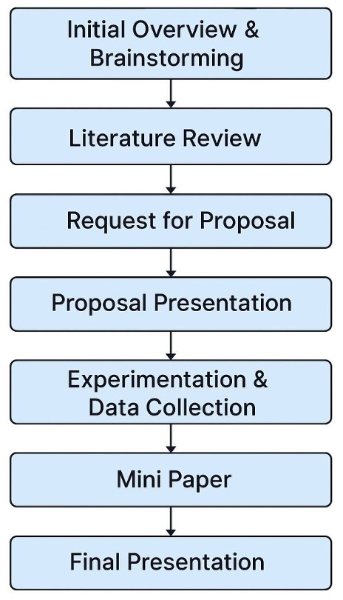
Week 5 | Apr28 | Apr29 | Collect Data I
Week 6 | Apr29 | Apr30 | Collect Data II
Week 7 | May5 | May6 | Collect Data III
Week 8 | May12 | May13 | Present initial results; hypotheses defense (google slides)
Week 9 | May19 | May20 | Mini paper due (use lab for peer-feedback)
Week 10 | Jun2 | Jun3 | Final project presentation
Notes:
Relevance

